Slide 1

2023 ANNUAL MEETING OF THE
BERMUDA DRUG INFORMATION NETWORK
Bermuda’s Drug Situation:
Update on Key Indicators
  Kyla Raynor, DrPH
  BerDIN Coordinator
  Senior Research Officer/Policy Analyst, DNDC
  November 3rd, 2023
  Bermuda Underwater Exploration Institute
Notes:
Welcome everyone to the 2023 meeting
With most of the membership here today I like to thank you for your continued efforts to provide the very best information we can collect to inform the drug situation in Bermuda
There have been a number of challenges for all of us over the past year but as Mr Santucci mentioned, but I would like to encourage each of us to think about how we can improve on how we collect information and/or how we can improve upon the process to ensure quality information is available

Slide 2


BERMUDA DRUG INFORMATION NETWORK
1998 UNGASS meeting where the United Nations Drug Control Programme (UNDCP), now United Nations Office on Drugs and Crime (UNODC), was mandated to aid with data comparability.
  2006 Throne Speech Initiative; formed in 2008.
  Re-engaged in 2012
  13th Annual Meeting
2
Notes:
This information network was started because of a directive from the United Nations.
In 1998, they mandated that counties provide key drug related information for comparability from country to country.
In Bermuda, the BerDIN was formed in 2008, took a hiatus for 4 years and then reengaged in 2012.
As challenging as the past year has been, you remain engaged evident by your participation in the meeting.
Despite having our own challenges we are here for the 13th annual meeting

Slide 3
BACKGROUND
OBJECTIVES
To provide information essential for policy making, organisation of drug-related services, and on drug-related issues of general interest.
Identify existing drug abuse patterns
Monitor changes/ emerging drug problems
Raise awareness through dissemination of information
Identify changes in drug abuse patterns
Integrate agencies involved in drug reduction or control
MISSION
The BerDIN is committed to providing the evidence that allows for discussions and decisions to be informed by sound, centrally available, local data, on a wide range of issues that increase understanding of the complex, dynamic, and evolving nature of the Island’s drug problem.
PURPOSE
→ Build a Bermuda picture to analyse the situation and the evolution of the phenomenon and responses.
→ Compile information used to monitor and assess the implementation of the national drug strategy.
FACILITATED & COORDINATED BY DNDC
→ Collect, collate, monitor, analyse, interpret, produce, and disseminate.
→ Standardise drug literature dissemination mechanism and processes.
→ Conduct primary drug-related research.
→ Provide technical assistance and capacity building.
A group of people who represent either themselves or an agency that aims to provide Bermuda with factual, objective, and comparable information concerning drugs and drug addiction, and their consequences.
Notes:
Our mission, purpose, and objectives are all tailored to contribute to the development of policy and the implementation of appropriate programmes and responses to the current drug situation.
The DNDC’s job really is to collect the information and make sense of it all through the annual publication.
The agencies making up the Network provide national information that assists the public, policy makers and anyone working in this field with having a local, culturally-relevant picture of the current substance use/misuse situation in Bermuda.

Slide 4
IMPORTANCE OF THE BERDIN
Multi-faceted Approach
Uses a multi-source, multi-indicator system to provide insight into various aspects of the drug problem because substance use is a difficult and complex phenomenon to monitor.
Centralised Reporting Hub
Provides a platform for agencies to report and share their information.
Collaboration & Collective Knowledge Exchange
Brings together various institutions and individuals involved in diverse aspects of the drug problem: drug prevention, treatment, education, control, health, and law enforcement.
Comprehensive Drug-Related Focus
Creates a holistic approach to address the various facets of drug-related issues, thereby promoting a more effective response.
4
Notes:
There is no one piece of information that can inform the drug situation in Bermuda. It requires a multitude of information from various sectors in order to observe, monitor, and evaluate the drug situation, even at times using proxy information
Being a part of BerDIN offers……
BerDIN also allows each of the Member agency’s information to be showcased, whereas, in some agencies, there is no reporting mechanism.
We all come from diverse areas AND so this meeting, brings all of us together who have a vested interest in demand and supply reduction, thereby creating a holistic approach…

Slide 5
MONITORING MECHANISMS
Since 2006
From 7 to 32 data providers
45 drug control areas
150+ indicators
17-year series for most indicators
Notes:
It is impressive achievement that this fledgling monitoring mechanism, established in 2008, has now matured into a national system, encompassing over 30 data providers (in Appendix I in the report), and is recognised both locally and internationally.

Slide 6

ORGANISATIONAL CHALLENGES
STAFFING
Shortages, turnover, or organisation restructure resulting in a need for relationship building and advocacy.
DATA
Key indicators not reported by interdiction agency.
Still unable to obtain robust Drug Prevention data to add to the report.
TIMELINESS
Not all agencies met the target submission date.
Time lag in processes affecting data availability.
QUALITY
Key partner unsure of data validity
Validity checks not built into process
6
Notes:
During 2022, agencies continued to struggle financially because of decreased budgets which resulted in challenges related to staffing, meeting deadlines and just having a resource person that could provide us with the information we are hoping to receive.
Since the pandemic, there have been a number of governmental and non-governmental agencies that have been simply unable to meet demands and, in a few cases, have had to make tough decisions in order to continue in a limited capacity.
Having met with a key data provider over the summer, we had a discussion about the information that was provided and the individual did not have confidence that the information being provided was accurate
So agencies need to have a verification process in place to ensure confidence in the data that is being released.

Slide 7
SIGNIFICANT DATA MISSING
FROM THE REPORT
CRIME
01
04
DRUG-RELATED ARRESTS
MISSING DATA
DRUG IMPORTATION VS. LOCAL OFFENCES
02
05
ALCOHOL- & DRUG-RELATED TRIALS & CONVICTIONS
DRUG PRICES
03
06
HEALTH: INPATIENT, ER, MWI ALCOHOL & DRUG-RELATED INFORMATION
7
Notes:
Points 1-4 of this slide contains information that we use to obtain from BPS and is now missing from the report.
At the end of each meeting we encourage each of you to have bilateral meetings and in that regard, We have tried numerous times to figure out a plan to move forward but we are met with promises of resolution within actually obtaining a resolution
Today we will have a presentation from the BPS on activities for 2022, information that was not available through their IT department
Point 5, although not confirmed, because it was difficult to get a response to my query from the BPS court liaison, the issues with very little data in the JEMS system is believed to also be related to BPS.
Point 6- with the implementation of the new BHB system, we were unable to provide any information from the old system.

Slide 8
KEY INDICATORS:
Substance-related facts
People say they feel safe in their neighborhoods.
Significant increase of cash, cannabis, crack cocaine, heroin seized.
DUI court saw increase in referrals, admissions and completions.
Youth admit to using (as of October 2023):
MARIJUANA Lifetime 11.9% Current 5.3%
ALCOHOL Lifetime 45.5% Current 11.9%
VAPE Lifetime 16% -
Sources: Annual Report of the Bermuda Drug Information Network, 2023
Survey of Middle and Senior School Students on Alcohol, Tobacco, Other Drugs and Health, October 2023
Notes:
Despite the challenges, I sat with the data and this is what we can report:
We know from the omnibus survey that people admit to feeling more secure/safe in their neighborhoods
Financial crime data and information from the government lab indicates SIGNIFICANT INCREASE OF CASH CANNABIS CRACK COCAINE AND HEORIN SEIZED
Stephanie’s presentation will provide more details but Preliminary data on 3/4 of the respondents who participated in the school survey a few weeks ago shows that when it comes to ever trying drugs AND past 30 day use……

Slide 9
PREVALENCE OF USE BY SEX
Drug | Lifetime Overall | Lifetime Male | Lifetime Female | Current Overall | Current Male | Current Female
Vape | 16.0% | 13.6% | 18.2% | - | - | -
Alcohol | 45.5% | 41.5% | 49.4% | 11.9% | 10.4% | 13.2%
Marijuana | 11.9% | 79.9% | 78.9% | 5.3% | 4.9% | 5.8%
Notes:
Preliminary results on ¾ of the student respondents shows…..
For the first time we see that females have higher rates of current use for both alcohol and marijuana
16% of students admitted to ever trying to vape….females more likely to have used then males

Slide 10




KEY INDICATORS:
Youth Substance Use
Have you ever ridden in a vehicle driven by someone who had been drinking alcohol?
587
447
140
BIKE
CAR
TOTAL
Sources: Survey of Middle and Senior School Students on Alcohol, Tobacco, Other Drugs and Health, October 2023
Notes:
This is an interesting statistic that I wanted to share…that close to 600 students said they had ridden in a car with someone who had been drinking
More specifically…

Slide 11
KEY INDICATORS:
Substance-related facts
Decrease
in DTC and DUI referrals, admissions and completions.
Increase in number of youth substance referrals.
More reception inmates positive for illicit drugs.
Decline in THC use during pregnancy.
Increase in number of suspicious deaths related to drugs.
11
Notes:
There have been some decreases in programme admissions over the past year and increases in other areas such as……..
A positive aspect is the decrease in THC use during pregnancy

Slide 12
ALCOHOL IMPORTS
AND LIQUOR LICENCES
Alcohol for Home Consumption ($mil)
Number of Liquor Licences Issued
  435 bartenders TIPS certified in 2022
Sources: HM Customs, Liquor Licence Authority
Notes:
As we look at the environment in which alcohol use occurs…..on the left we have alcohol imports and the number of liquor licenses issued on the right.
The graph on the left shows the value in millions of dollars of alcohol imported for local consumption which saw a slight increase in 2022, as well as a slight increase in the number of liquor licenses issued
We also know that the TIPS programme, facilitated by CADA certified 435 bartenders in 2022, which was almost 100 people less than in 2021.

Slide 13


2022 RETAIL SALES INDEX
AND CUSTOMS DUTY
Estimated Liquor Store Sales ($mil)
Estimated Duty Collected on Alcohol ($mil)
Source: Department of Statistics
Notes:
Here we have the estimated liquor store sales in millions on the left and the estimated duty collected on alcohol in millions on the right.
Not surprising but as you can see the months of July and December had the highest gross sales of alcohol
So we know that $30 million worth of alcohol was available for consumption again seen in the previous slide, and that over $20 mil was collected in duty on that alcohol and there were several hundreds of millions of dollars in gross sales
The most sales were for wine and beer

Slide 14
TREATMENT REFERRALS & ADMISSIONS
Source: Bermuda Assessment Referral Centre, MT, WTC, TP, Focus, SA
Notes:
Treatment referrals and admissions decreased between 2021-2022.

Slide 15
SUBSTANCE OF CHOICE
  New clients had moderate clinical diagnosis vs existing clients who were likely to have severe diagnosis.
Source: Bermuda Assessment Referral Centre (BARC)
Notes:
These graphs show the substances of abuse or dependence by persons prior to a determination of the appropriate level of care.
From both charts we know that alcohol remains the drug of choice of those who presented for assessment over the past 2 years, followed by cocaine and were the substances most often indicated for abuse or dependence.

Slide 16


PERSONS IN TREATMENT
TREATMENT AGENCY | 2021 MALE | 2021 FEMALE | 2021 TOTAL | 2022 MALE | 2022 FEMALE | 2022 TOTAL
WTC | - | 12 | 12 | - | 6 | 6
MT | 15 | - | 15 | 3 | - | 3
TURNING POINT | 272 | 51 | 323 | 196 | 30 | 226
SALVATION ARMY HARBOUR LIGHT | 15 | - | 15 | 9 | - | 9
SALVATION ARMY LIFE SKILLS | 5 | - | 5 | 2 | - | 2
FOCUS | 13 | - | 13 | 7 | 1 | 8
RLH | 12 | - | 12 | 8 | - | 8
TOTAL | 332 | 63 | 395 | 225 | 37 | 262
16
Source: Bermuda Assessment Referral Centre (BARC)
Notes:
In 2022, of the 262 people in treatment, 37 were woman and 225 were men. TP was the treatment agency for most for both males and females.

Slide 17
LEVEL OF SEVERITY OF
SUBSTANCE ABUSE OR DEPENDENCE
Source: Bermuda Assessment Referral Centre (BARC)
Notes:
Again of those with substance abuse or dependence, most had severe abuse or dependence.

Slide 18
IMPAIRED DRIVING
DUI STOPS
BREATHALYSER RESULTS
  Almost half of persons stopped were 2 to 4 times above legal limit.
10 males 6 females 2-3 times above the limit
Source: Bermuda Police Service
Notes:
Chapter 6 discusses facts related to brethalyser results…..
If you remember, in 2018 BPS initiated road side sobriety testing.
In 2022, 114 persons were stopped and undertook the test of which 96 were male and 18 female. And as you can see Most persons who were stopped failed the breathalyzer test

Slide 19
DUI CLASS PARTICIPATION
Source: Bermuda Professional Counselling Service and FOCUS
Notes:
In 2022, FOCUS saw 7 partipants in their DUI class
Focus Counselling Services provides The Flex Module Impaired Driving Series approved by the Government of Bermuda in accordance with Section 35 (K) of the Road Traffic Act 1947.
This program satisfies the courts to make an order for the reduction in the period of disqualification under Section 4 of the Traffic Offences (Penalty) Act 1976 of a DUI/Impaired driving offender, upon successful completion.
The Flex Module Impaired Driving Series is a flexible version of the most widely replicated model for impaired driving offender intervention education. Certified addictions counsellors provide this participant-focused, user-friendly curriculum that offers a personalized road map for good decision-making; aligns with local impaired driving education standards; includes a personal change plan that can being integrated across the course; emphasizes personal responsibility and commitment to change drinking and driving behaviour; and moves beyond basic education to application of effective strategies for behaviour change.
The program runs for a six-week cycle totalling 12 hours with 2 hours per session and is held on Wednesday evenings from 5:30 pm to 7:30 pm at cost of $425. Full payment is required prior to programmme participation. The cost of the programme includes all materials. A certificate of completion is provided to all participants who complete the full programme along with application for reduction in disqualification period. The programme is geared toward Impaired Driving offenders and offender prevention.

Slide 20
MORTALITY DATA
2021
2022
Source: Central Government Lab
Notes:
These are deaths in which a toxicology screens occurred in 2022.
Of those suspicious deaths (59), Males- 48 and Females-11; most suspicious deaths were due to drugs
One person was less than 18 years
8 people that were age 18-25
3 people that were age 26-35
5 people that were age 36-45
25 people that were 46-60
17 people that were over the age of 60

Slide 21
DEMAND & SUPPLY REDUCTION EXPENDITURE
  Treatment services received the most funding in each year, over the past 12 years.
Source: Department of Finance
Notes:
The impact of overall decreased funding over the past several years has resulted in decreased/limited client services mainly due to staffing
A number of persons seeking care were unable to get into treatment over the past year while others waited for longer periods than usual
Substance abuse treatment: largest component of the budget saw level funding for the past 3 years.
This includes DNDC’s treatment programmes, grant agencies, RLH and turning point.
When it came to Substance use prevention
prevention unit of the DNDC saw level funding over the past year
prevention grant-recipient agencies saw level funding also for the past 3 years
When it came to the Interdiction budgets: BPS saw a decrease in their budget compared to the last budget cycle, while hm customs saw level funding.

Slide 22

DATA GAPS
CRIME
Drug arrests, persons stopped and warned for cannabis (7g legislation), drug availability and drug market
01
03
JUSTICE
Public expenditure on drug offenders in prison
TREATMENT
Problem drug use, dual-diagnosed clients, drug-related harms, treatment gaps
02
04
ECONOMY
Cost of problem drug use to society
22
Notes:
So, over the past 2 years there has been some regression in the availability of information.
While we have done a lot of great work, there remains key missing data, the pressing ones are listed here. Ideally, we the new drug strategy we would like to ensure that a few of the pressing issues are addressed
Missing indicators from agencies such as: although we have 2018 2019 2020 crime data, current crime (2021) data and drug prices
Problem drug use is another area we remain in the dark regarding, so how many addicted people we have in Bermuda from a population perspective, so not just social users but those who use consistently and may not necessarily be in the criminal justice system.
Concerning the drug market, for some years there has been a gap in our understanding of the correct formula to use in order to determine the dollar value of drugs seized by the Bermuda Police Service.
The public expenditure and cost of drugs study are two of the drug strategy objectives that we will be working towards of the remaining period of the strategy.
While these are just some of the gaps, it is highly possible there may be other indicators that we should look at especially as it related to cannabis and the use of synthetic drugs.

Slide 23
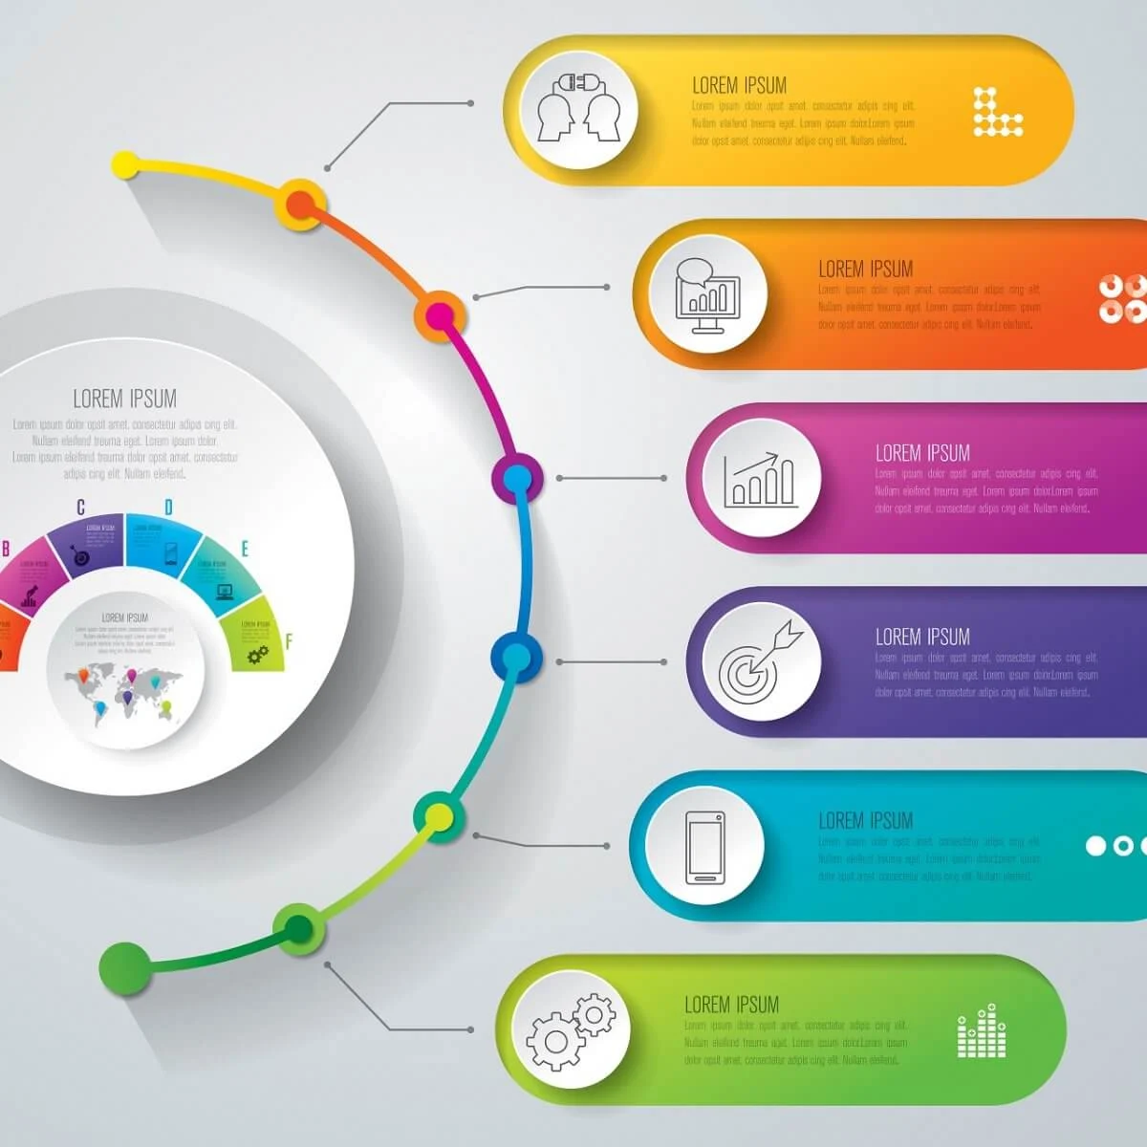

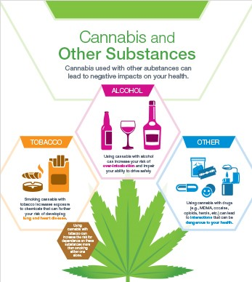
BEYOND 2023
Drug Strategy
Evaluation
New Strategy
Data Gaps
Methodology to consolidate drug control budgets
Persons stopped and cautioned under 7g legislation
Research
Drugs & alcohol- related accidents collaboration
Notes:
The drug control strategic plan expires in 2024 therefore…..
The number of persons stopped and cautioned under the Cannabis Amendment Act (7g legislation) has been in place since 2017 (5 years) however we still do not have a sense of the number impacted
We look forward to looking at the RTA data and hope to be able to report on that next year

Slide 24
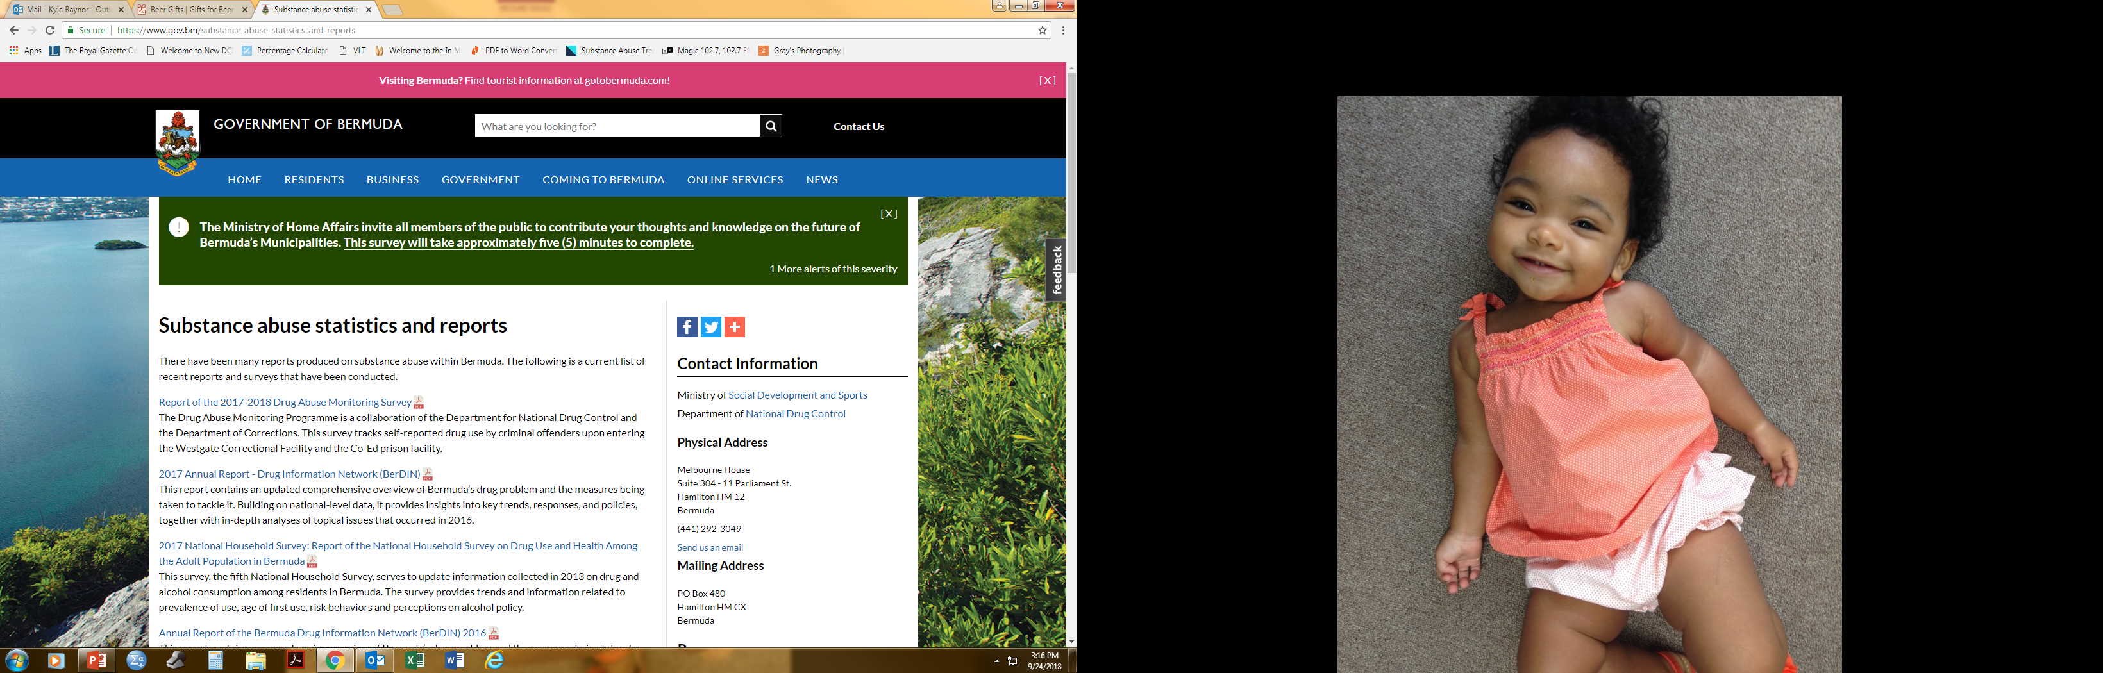
GOVERNMENT OF BERMUDA
GOV.BM
Notes:
I would like to remind you that all of the data produced by the DNDC Research Unit can be found on the government portal
However if there is something you can not find or if you are in need of customized data please contact us

Slide 25

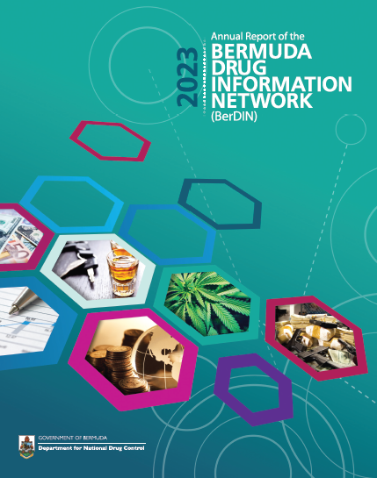
THANK YOU!
Notes:
We all should feel proud of contributing to and producing these 12 publications.
publications that stand as a resource – an evidence base – to both policy makers and the community alike
IT IS THE NUMBER ONE SOURCE OF COLLECTIVE INFORMATION RELATED TO DEMAND AND SUPPLY REDUCTION ON OUR ISLAND.
IF YOU HAVE ANY IDEAS OF HOW WE MAKE THESE BETTER OR MORE USEFUL DO LET US KNOW

